Slide 1

Synerduino STM Target Compilation into Hexfile
Synerduino STM Fork of INAV and the Synerduino Target

Slide 2
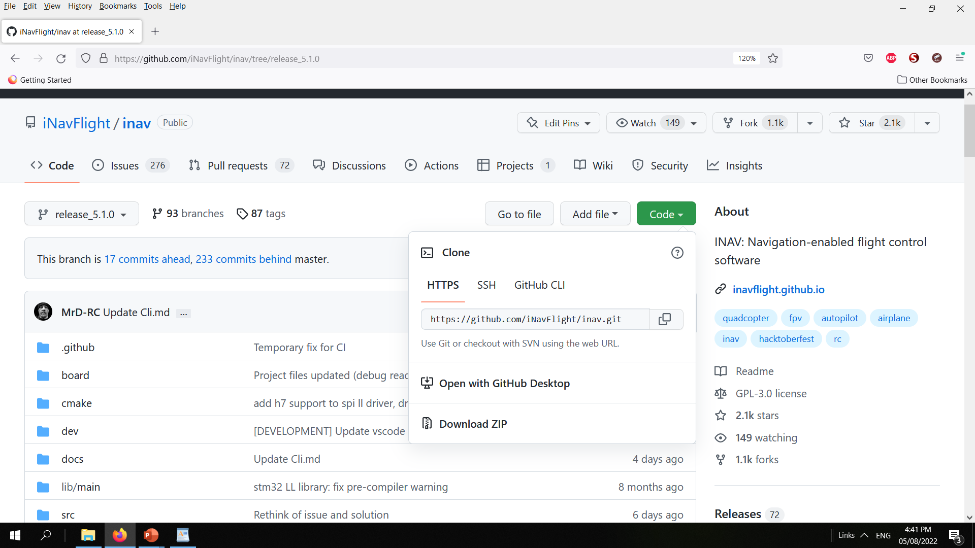
Download the INAV Release 5.1.0
Release 6.0.0
Release 7.0.0
Release 8.0.0
Prepare to Build the Hex File
First you need to download the INAV release version
These are available in the official github page or Synerflight SynerduinoSTM in download tab
https://github.com/iNavFlight/inav/tree/release_5.1.0
https://github.com/iNavFlight/inav/tree/6.0.0
https://github.com/iNavFlight/inav/tree/7.0.0

Slide 3
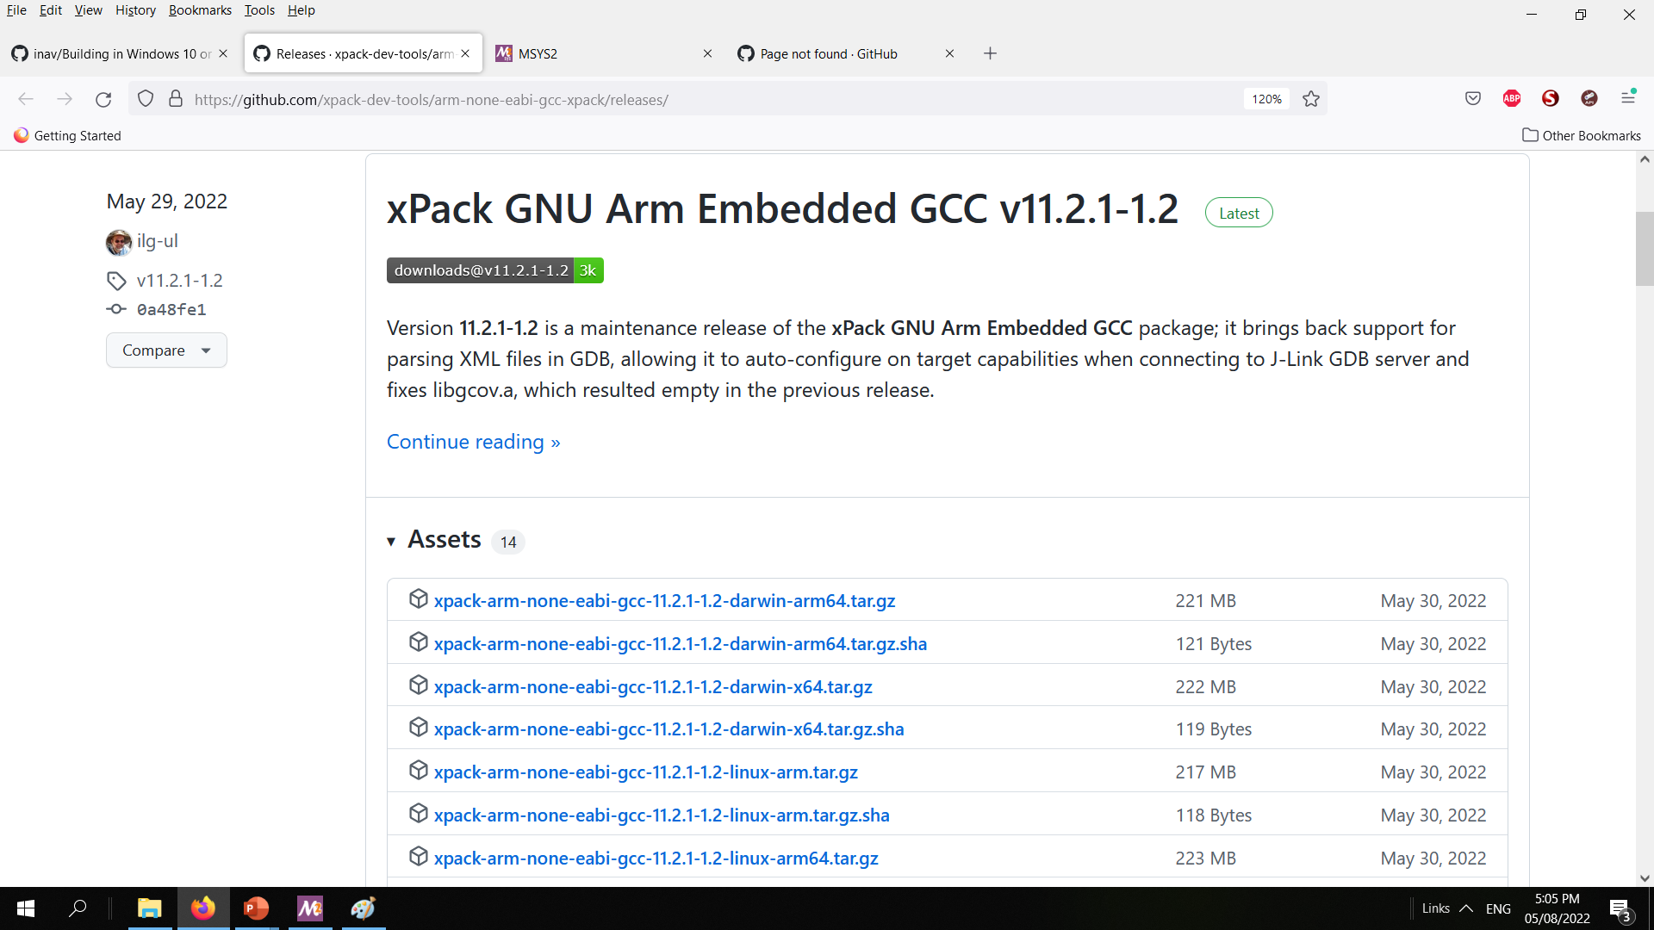
INAV–5.1.0 / INAV-6.0.0
Download the Xpack Release 10.2.1-1.1-Win32-x64
INAV–7.0.0
Download the Xpack Release 10.3.1-2.2-Win32-x64
INAV–8.0.0
Download the Xpack Release 12.2.1-1.1-Win32-x64
These are available in the official github page or Synerflight SynerduinoSTM in download tab
https://github.com/xpack-dev-tools/arm-none-eabi-gcc-xpack/releases/
https://github.com/xpack-dev-tools/arm-none-eabi-gcc-xpack/releases/download/v9.2.1-1.1/xpack-arm-none-eabi-gcc-9.2.1-1.1-win32-x64.zip
https://github.com/xpack-dev-tools/arm-none-eabi-gcc-xpack/releases/download/v10.2.1-1.1/xpack-arm-none-eabi-gcc-10.2.1-1.1-win32-x64.zip
https://github.com/xpack-dev-tools/arm-none-eabi-gcc-xpack/releases/download/v10.3.1-2.2/xpack-arm-none-eabi-gcc-10.3.1-2.2-win32-x64.zip
https://github.com/xpack-dev-tools/arm-none-eabi-gcc-xpack/releases/download/v13.2.1-1.1/xpack-arm-none-eabi-gcc-13.2.1-1.1-win32-x64.zip

Slide 4
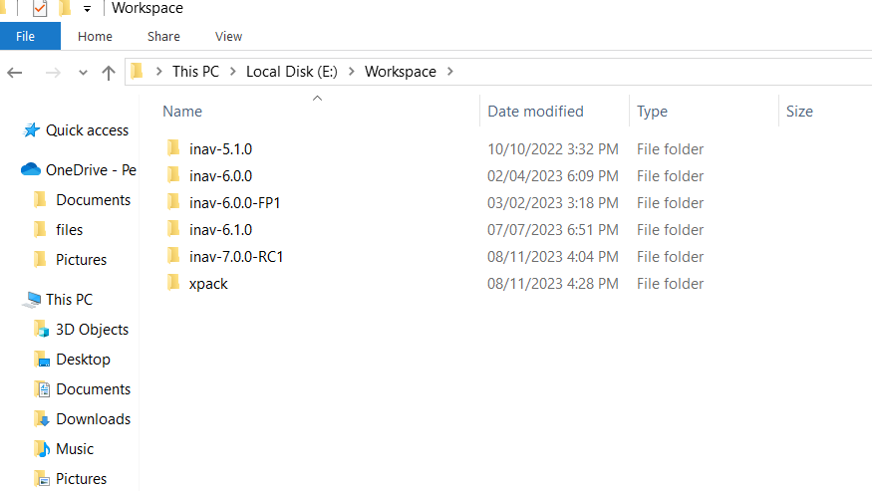
After installation Go Create a Workspace folder in your local Drive in my case Drive E , and extract and place the following directories INAV-5.1.0 / INAV-6.0.0 / INAV-7.0.0 /INAV8.0.0 Folder , Xpack folder
Note: I place my Workspace Folder on Drive E: as I was using SSD on my Drive C so not to fill it up

Slide 5
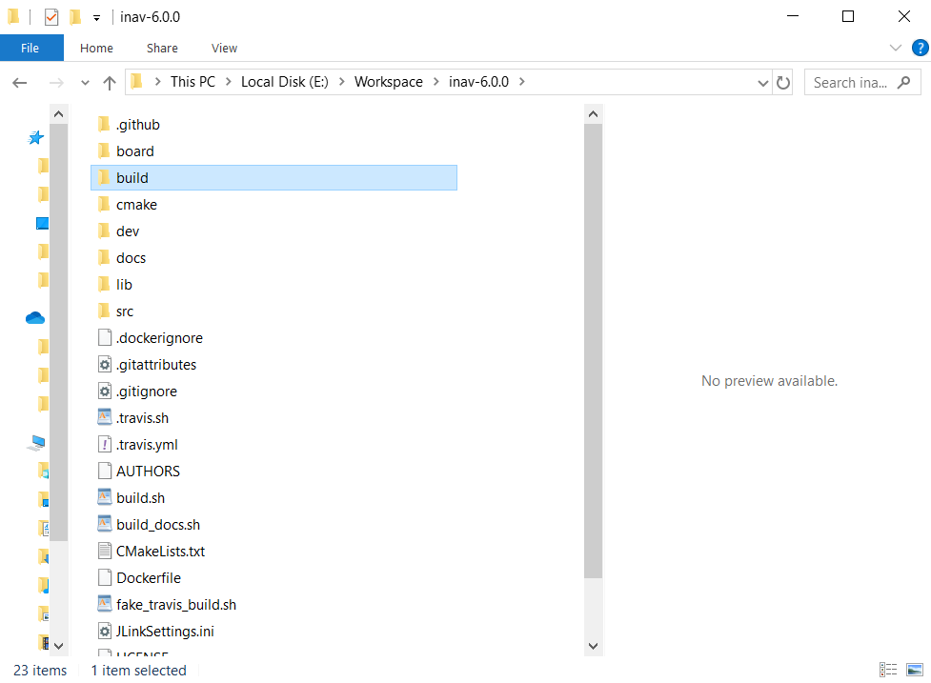
Create new folder inside
INAV 5.1.0
INAV 6.0.0
INAV 7.0.0
INAV 8.0.0
Directory and Name it build

Slide 6
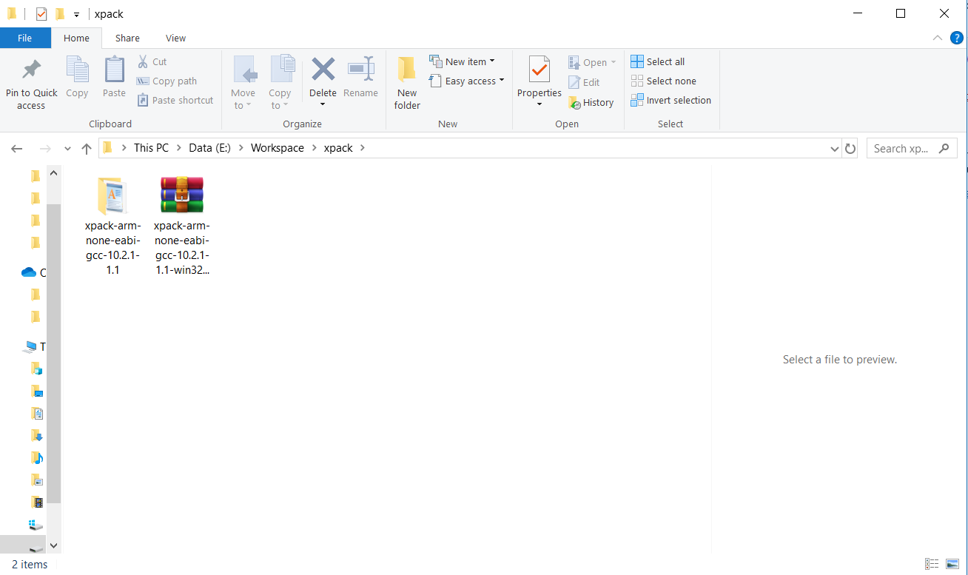
Inside the Xpack Folder Extract the xpack-arm-none-eabi-gcc -10.2.1-1.1
Create an xplack folder in Workspace folder and place it in there
INAV 5.1.0 INAV 6.0.0
xpack-arm-none-eabi-gcc-10.2.1-1.1 is extracted to the Xpack folder
INAV 7.0.0
xpack-arm-none-eabi-gcc-10.3.1-2.2 is extracted to the Xpack folder
INAV 8.0.0
xpack-arm-none-eabi-gcc-13.2.1-1.1 is extracted to the Xpack folder

Slide 7
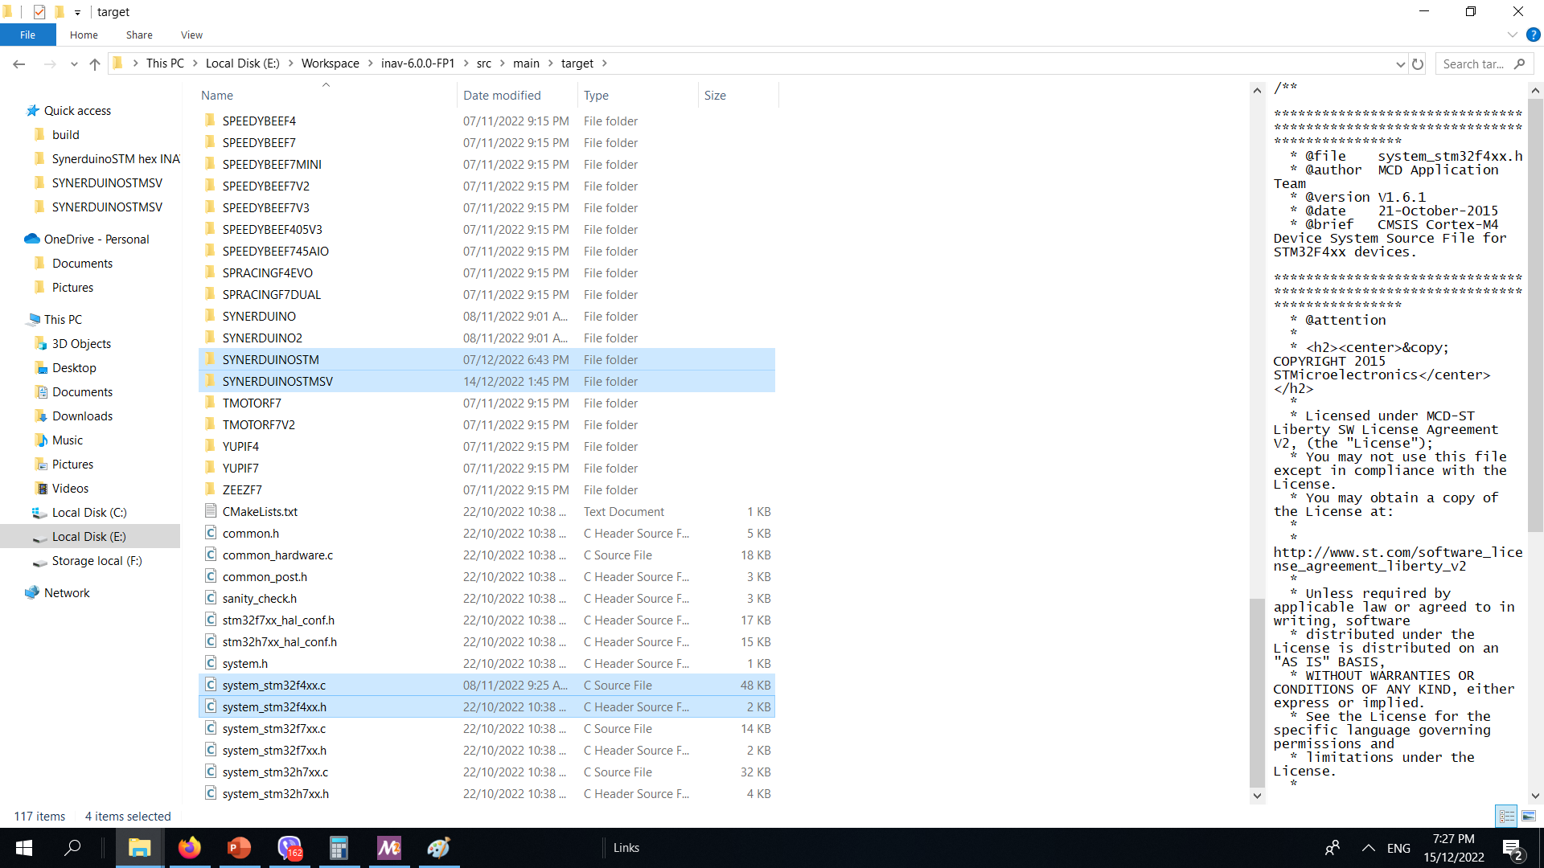
Download the Synerduino Target Folder and Extract to Local drive and place it in the following
(E/Workspace/inav-5.1.0/scr/main/target)
(E/Workspace/inav-6.0.0/scr/main/target)
(E/Workspace/inav-7.0.0/scr/main/target)
(E/Workspace/inav-8.0.0/scr/main/target)
Readme file is also available in the download
System_stm32f4xx.c – is modify to suit the Synerduino STM
INAV 7.0.0 when F411 BP became official)
INAV 8.0.0 F411 discontinued due to size limitation

Slide 8
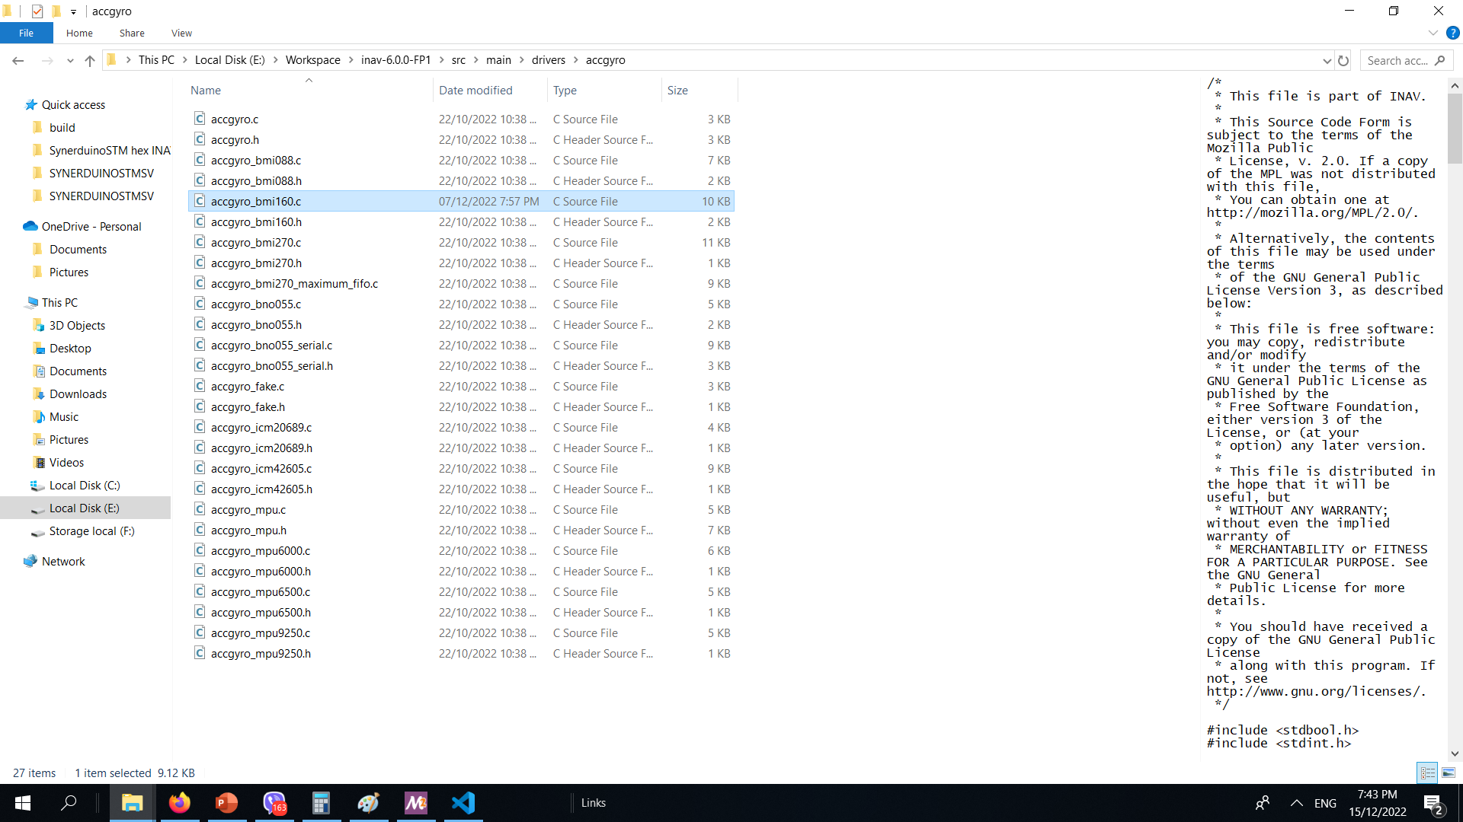
Other Download of the Synerduino Target Folder is the sensor driver this is also Extract to Local drive and place it in the following
(E/Workspace/inav-5.1.0/scr/main/drivers/accgyro) ,
(E/Workspace/inav-6.0.0/scr/main/drivers/accgyro) ,
(E/Workspace/inav-7.0.0/scr/main/drivers/accgyro)
(E/Workspace/inav-7.1.0/scr/main/drivers/accgyro)
(E/Workspace/inav-8.0.0/scr/main/drivers/accgyro)
Readme file is also available in the download (accgyro_BMI160) is also modify to use with the SynerduinoSTM shield

Slide 9
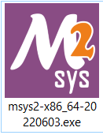
General Info
This is a guide on how to use Windows MSYS2 distribution and building platform to build iNav firmware. This environment is very simple to manage and does not require installing docker for Windows which may get in the way of VMWare or any other virtualization software you already have running for other reasons. Another benefit of this approach is that the compiler runs natively on Windows, so performance is much better than compiling in a virtual environment or a container.
Download Arm Embedded GCC toolkit from The xPack Project
https://xpack.github.io/arm-none-eabi-gcc/
Download MSYS2 for your architecture (most likely 64-bit)
https://www.msys2.org/wiki/MSYS2-installation/
Install and Run msys2-x86

Slide 10
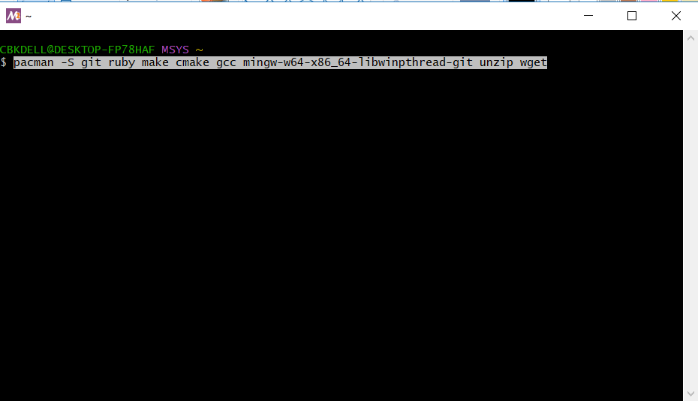
Copy and paste this script to install Ruby ,Cmake , Make and Gcc
pacman -S git ruby make cmake gcc mingw-w64-x86_64-libwinpthread-git unzip wget

Slide 11
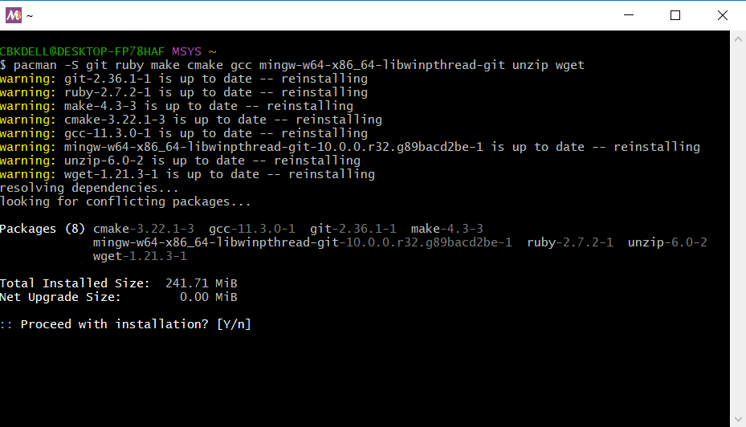
Y to Proceed installation
pacman -S git ruby make cmake gcc mingw-w64-x86_64-libwinpthread-git unzip wget

Slide 12
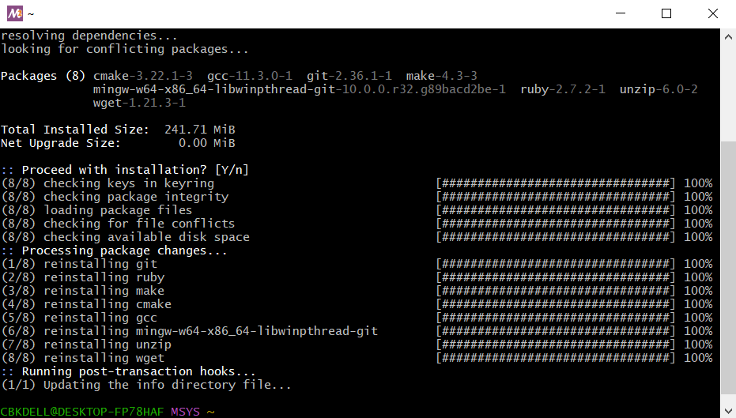
After installation
pacman -S git ruby make cmake gcc mingw-w64-x86_64-libwinpthread-git unzip wget

Slide 13
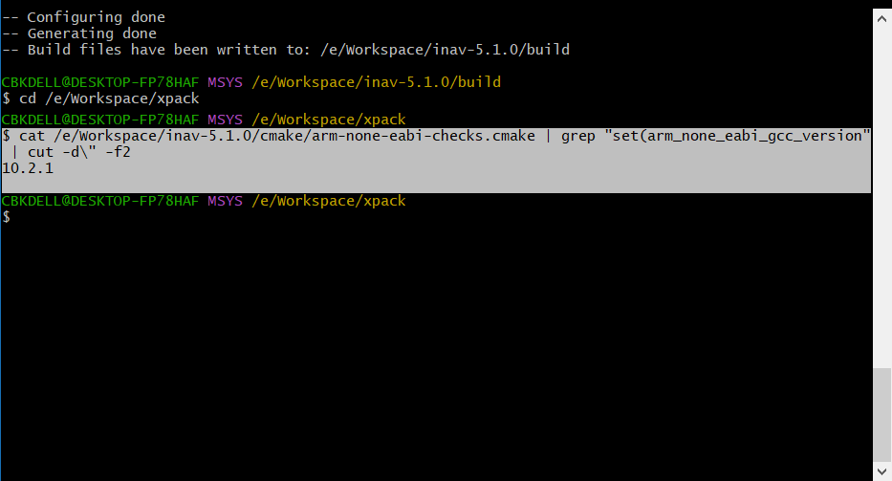
To get the toolkit version you need for your INAV version
# for INAV version 5.0.0, 6.1.0 toolchain version needed is 10.2.1
# for INAV version 7.0.0 , 7.1.2 toolchain version needed is 10.3.1
# for INAV version 8.0.0 , 8.1.1 toolchain version needed is 13.2.1
Source the version number that needs to be downloaded
Go to Xpack directory by typing
cd /e/Workspace/xpack
cat /e/Workspace/inav-8.0.0/cmake/arm-none-eabi-checks.cmake | grep "set(arm_none_eabi_gcc_version" | cut -d\" -f2
cat /e/Workspace/inav-7.1.2/cmake/arm-none-eabi-checks.cmake | grep "set(arm_none_eabi_gcc_version" | cut -d\" -f2
cat /e/Workspace/inav-7.1.0/cmake/arm-none-eabi-checks.cmake | grep "set(arm_none_eabi_gcc_version" | cut -d\" -f2
cat /e/Workspace/inav-7.0.0/cmake/arm-none-eabi-checks.cmake | grep "set(arm_none_eabi_gcc_version" | cut -d\" -f2
cat /e/Workspace/inav-6.0.0/cmake/arm-none-eabi-checks.cmake | grep "set(arm_none_eabi_gcc_version" | cut -d\" -f2
cat /e/Workspace/inav-5.1.0/cmake/arm-none-eabi-checks.cmake | grep "set(arm_none_eabi_gcc_version" | cut -d\" -f2

Slide 14
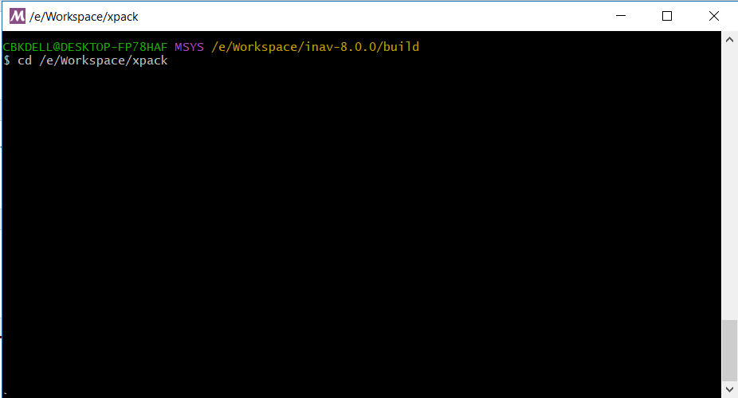
Go to Xpack directory by typing
cd /e/Workspace/xpack

Slide 15
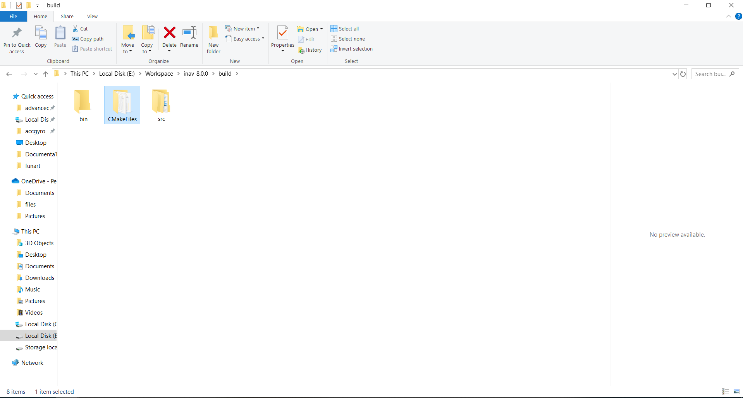
Build Folder
E/Workspace/INAV-8.0.0/build
If you have an old CMakeFiles folder of a different versions
Delete it before Exporting a new path

Slide 16
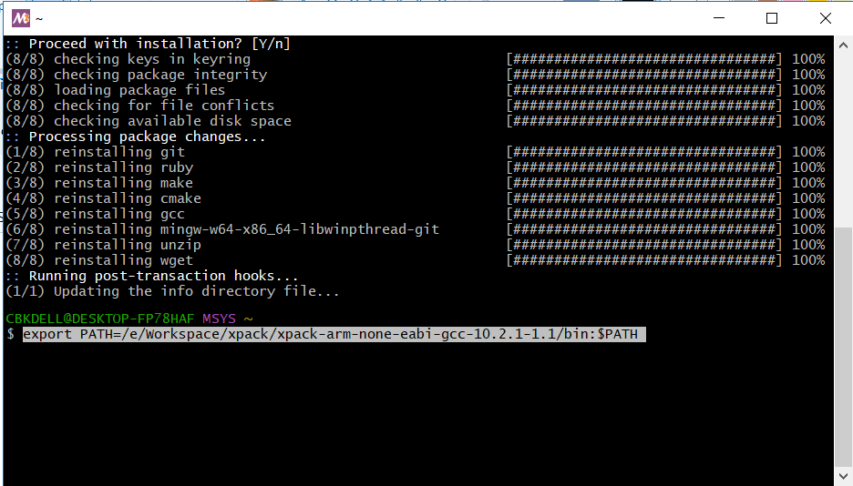
Set a Path for the Exported GCC to the Environment Pls make sure the directory is same name as the folder
INAV 5.1.0 – 6.1.0
export PATH=/e/Workspace/xpack/xpack-arm-none-eabi-gcc-10.2.1-1.1/bin:$PATH
INAV 7.0.0 – 7.1.2
export PATH=/e/Workspace/xpack/xpack-arm-none-eabi-gcc-10.3.1-2.2/bin:$PATH
INAV 8.0.0
export PATH=/e/Workspace/xpack/xpack-arm-none-eabi-gcc-13.2.1-1.1/bin:$PATH

Slide 17
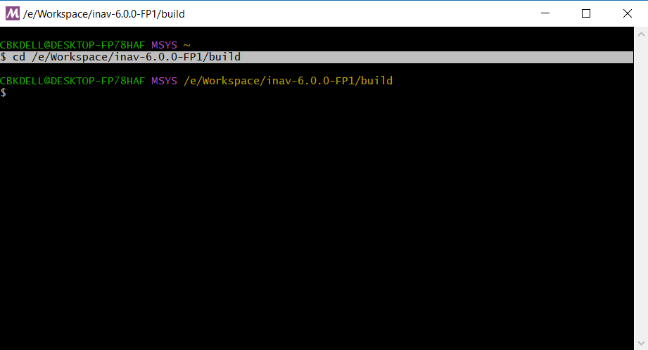
Go to the build directory by entering this command
cd /e/Workspace/inav-5.1.0/build
cd /e/Workspace/inav-6.1.0/build
cd /e/Workspace/inav-7.0.0/build
cd /e/Workspace/inav-7.1.0/build
cd /e/Workspace/inav-7.1.1/build
cd /e/Workspace/inav-7.1.2/build
cd /e/Workspace/inav-8.0.0/build
cd /e/Workspace/inav-8.0.0-RC3/build

Slide 18
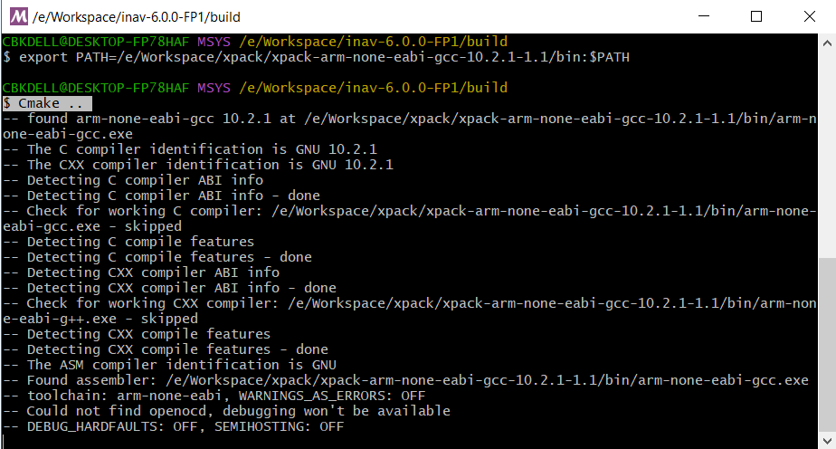
This will extract the Cmake into the build folder creating the Environment
Cmake ..
You may need to run rm -rf * in build directory if you had any failed previous runs now run cmake

Slide 19
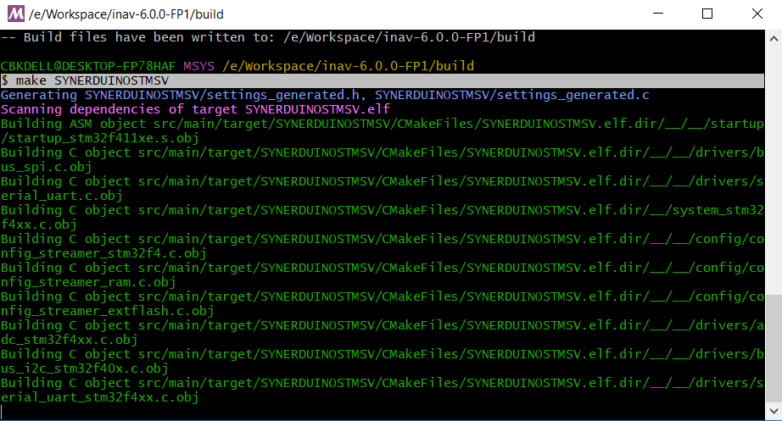
This will build the Hexfile Targeted the Synerduino board and its settings to the Build Folder the
Hexfile is use as Firmware when loading the configurator
INAV6
make SYNERDUINOSTM
INAV7
make SYNERDUINOSTM_F411
make SYNERDUINOSTM2
INAV8
make SYNERDUINOSTM_F405
make SYNERDUINOSTMSV
make SYNERDUINOSTM_H743
make SYNERDUINOSTMSV2
make SYNERDUINOSTM_H743A

Slide 20
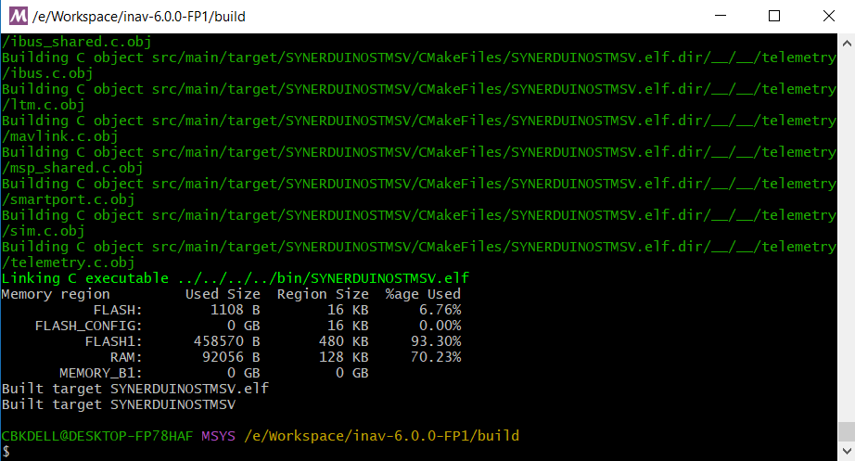
Once completed the Hexfile can be found on the Build folder

Slide 21
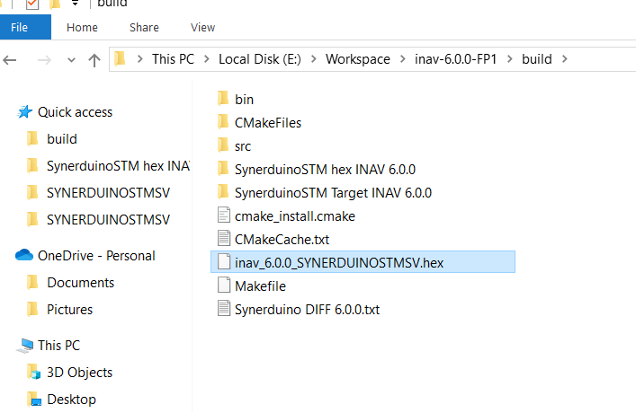
And… its here .
INAV_5.1.0 SYNERDUINOSTM.hex
INAV_5.1.0 SYNERDUINOSTMSV.hex
INAV_6.0.0_SYNERDUINOSTM.hex
INAV_6.0.0_SYNERDUINOSTMSV.hex
INAV_7.0.0_ SYNERDUINOSTM_F411.hex
INAV_8.0.0_ SYNERDUINOSTM_F405.hex
Open this file in the Configurator as this is the firmware
Find it in the Build folder of the INAV directory
cd /e/Workspace/inav-5.1.0/build
cd /e/Workspace/inav-6.0.0/build
cd /e/Workspace/inav-7.0.0/build
cd /e/Workspace/inav-7.1.0/build
cd /e/Workspace/inav-7.1.1/build
cd /e/Workspace/inav-8.0.0/build

